Slide 1
Capstone Engagement
Assessment, Analysis, and Hardening of a Vulnerable System

Slide 2
Table of Contents
This document contains the following sections:
01
Network Topology
02
Red Team: Security Assessment
03
Blue Team: Log Analysis and Attack Characterization
Hardening: Proposed Alarms and Mitigation Strategies
04

Slide 3
Network Topology
‹#›

Slide 4
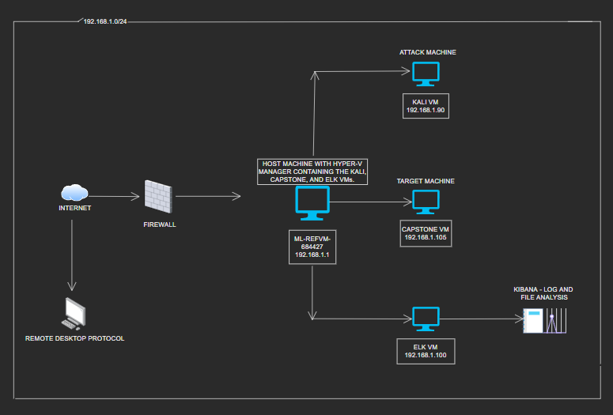
Network Topology
Network
Address Range: 192.168.1.0/24
Netmask: 255.255.255.0
Gateway: 10.0.0.1
Machines
IPv4: 192.168.1.1
OS: Windows
Hostname: ML-REFVM-684427 (Hyper-V Manager)
IPv4: 192.168.1.90
OS: Linux
Hostname Kali:
IPv4: 192.168.1.105
OS: Linux
Hostname: Capstone
IPv4: 192.168.1.100
OS:
Hostname: ELK

Slide 5

Red Team
Security Assessment
‹#›

Slide 6
Recon: Describing the Target
Nmap identified the following hosts on the network:
Hostname | IP Address | Role on Network
ML-REFVM-684427 (Hyper-V Manager) | 192.168.1.1 | Hyper-V manager which hosts the following 3 VMs (Kali, Capstone, & ELK)
Kali | 192.168.1.90 | Attack machine - used to find vulnerabilities (Penetration Testing)
Capstone | 192.168.1.105 | Target machine - the vulnerable server
ELK | 192.168.1.100 | Network monitoring machine which runs Kibana and logs the data from the target machine (Capstone)

Slide 7
Vulnerability Assessment
the assessment uncovered the following critical vulnerabilities:
Vulnerability | Description | Impact
Improper Restriction of Excessive Authentication Attempts CWE-307 | The site does not implement sufficient measures to prevent multiple failed authentication attempts within a time frame, making it susceptible to brute force attacks | When the site is susceptible to brute force attacks, the security of the confidential information stored is at high risk of being exposed.
Sensitive Data Exposure CWE-200 | This vulnerability exposes sensitive information to an actor that is not explicitly authorized to have access. | Sensitive data can include private personal information, business secrets, network configuration, which can all be leveraged to obtain access to other
Local File Inclusion (LFI) | This is a vulnerability within poorly designed web applications, allowing uploaded content into the servers. | Usernames and passwords that are weak and noncomplex can be easily cracked and/or guessed by attackers and their computers.

Slide 8
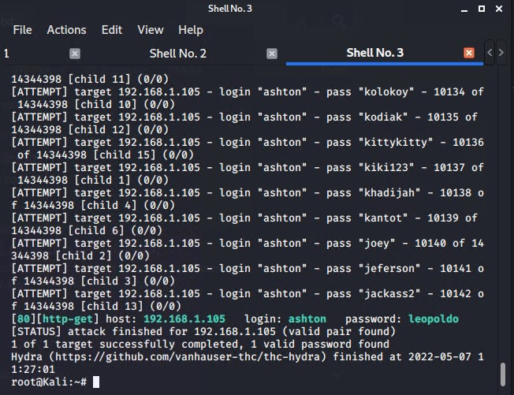
Exploitation: Improper Restriction of Excessive Authentication Attempts CWE-307
01
02
Tools & Processes:
This vulnerability was shown through a successful brute force attack, which was implemented using Hydra (pre installed on Kali Linux).
This brute force attack also utilized the rockyou.txt password list.
Achievements:
This exploitation provided the password for Ashton’s login credentials.
Eventually, this lead to my access of the secret folder, the webdav system, and Ryan’s password, allowing access to all of the sensitive information.

Slide 9
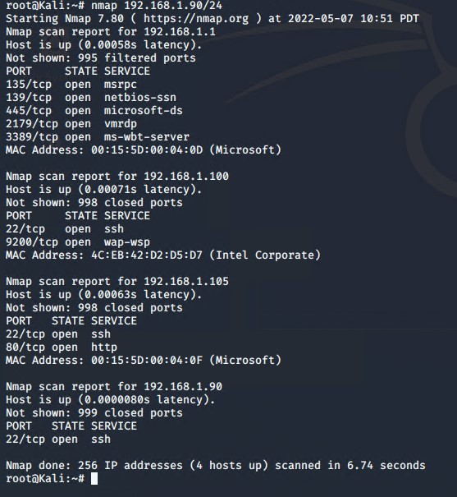
Exploitation: Sensitive Data Exposure CWE-200
01
02
Tools & Processes:
The nmap command was used to scan the network for open ports and providing the IP addresses.
Achievements:
Utilizing nmap provided the target server’s URL and IP address.

Slide 10
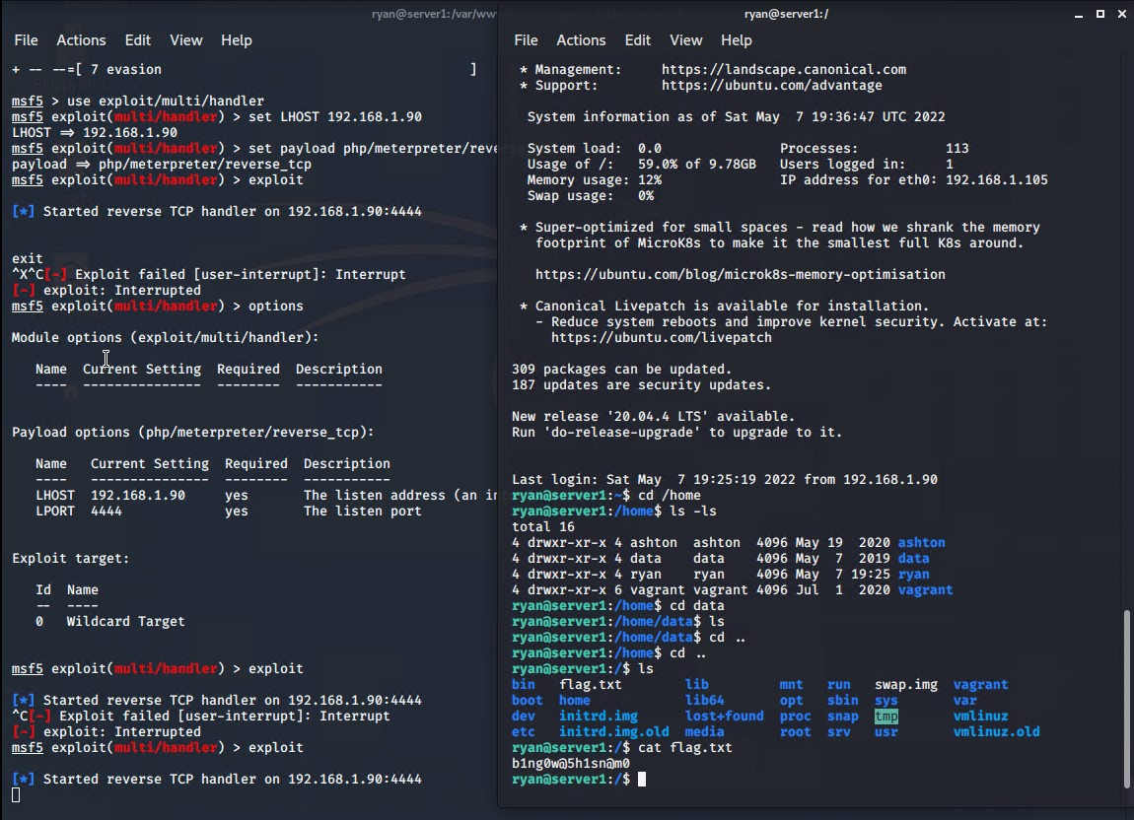
Exploitation: Local File Inclusion CWE-98
01
02
Tools & Processes
“msfvenom” and “meterpreter” were utilized to deliver a payload to the target machine, ultimately allowing access to the “flag.”
Achievements
Meterpreter’s “multi/handler” option allowed access to the target machine’s shell.

Slide 11

Blue Team
Log Analysis and Attack Characterization
‹#›

Slide 12

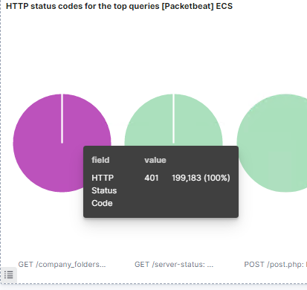
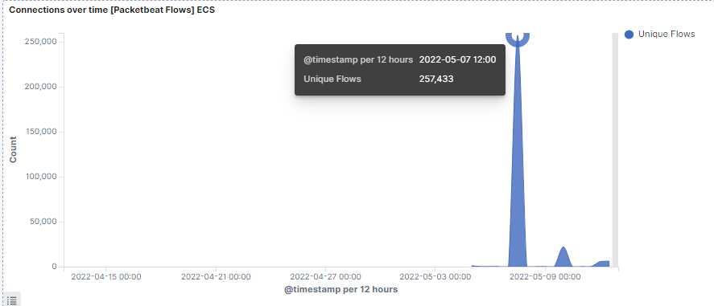
Analysis: Identifying the Port Scan
The port scan occurred at 18:20 on 5/7/22.
192.168.1.90 sent 159,259 packets to 192.168.1.105.
The unusually high volume of hits as well as the number of HTTP Error 401 returns.

Slide 13
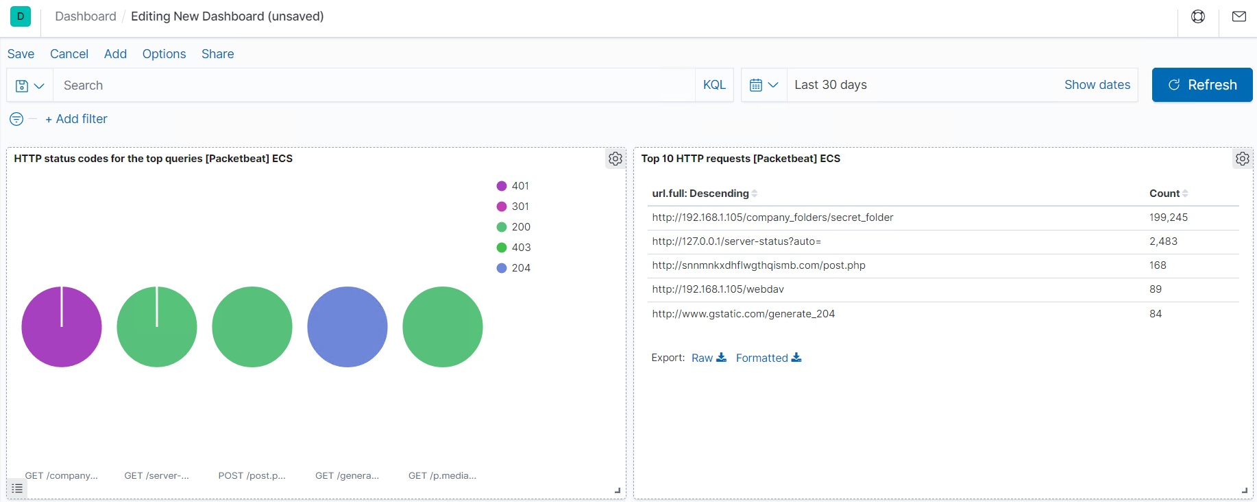
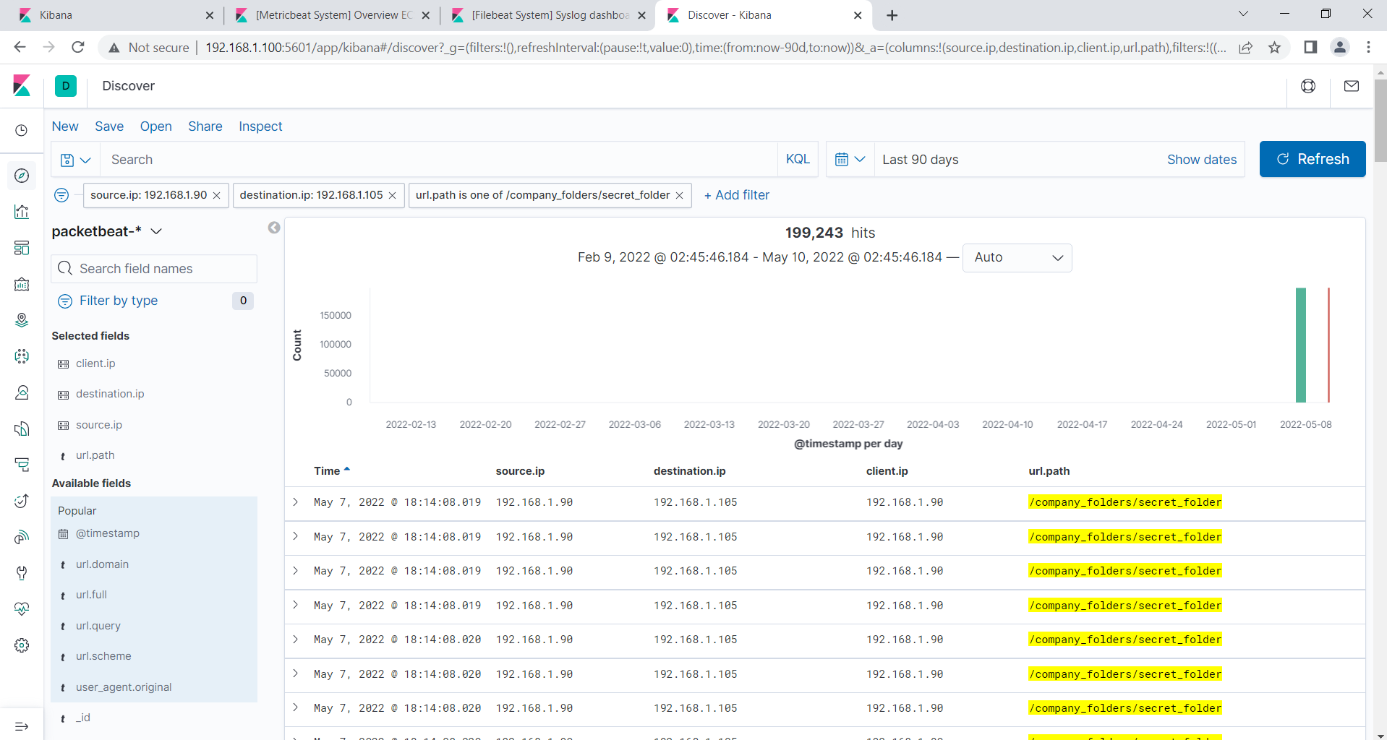
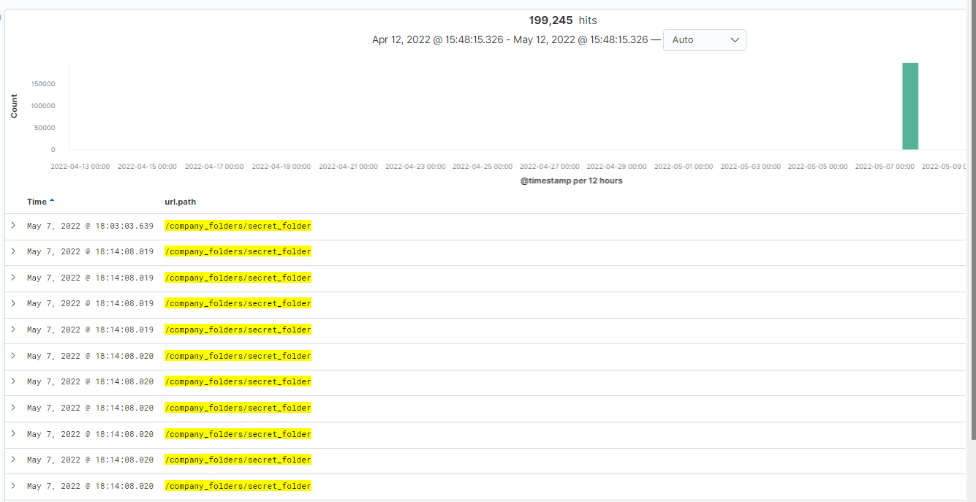
Analysis: Finding the Request for the Hidden Directory
There were 199,245 hits beginning at 18:03:03 on 5/7/22.
The /company_folders/secret_folder file was requested as well as /webdav.

Slide 14
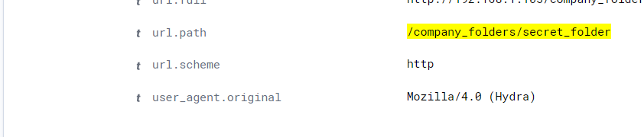
Analysis: Uncovering the Brute Force Attack
There were 199,245 packet requests during this Brute Force Attack.
There was only one successful connection, meaning the attacker had 199,244 attempts before finding success.

Slide 15
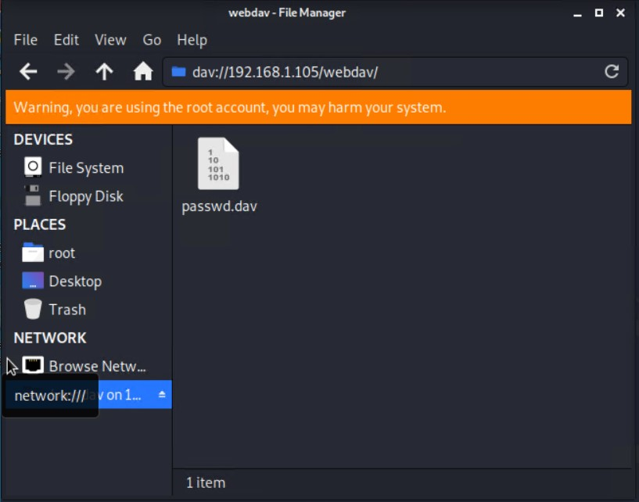
Analysis: Finding the WebDAV Connection
There were 114 requests made to this directory:
89 to http://192.168.1.105/webdav
25 to http://192.168.1.105/webdav/passwd.dav

Slide 16
Blue Team
Proposed Alarms and Mitigation Strategies
‹#›

Slide 17
Mitigation: Blocking the Port Scan
What kind of alarm can be set to detect future port scans?
An alert should be set which triggers when a single IP address send more than 10 requests per second. This will alert the proper people that there is a potential port scan occurring.
What configurations can be set on the host to mitigate port scans?
Put a firewall in place which can prevent malicious behavior over time.
Create rules and alarms that will help prevent malicious attacks by sending alerts when a specified threshold is met.
Utilizing tools such as Kibana and SPLUNK are efficient ways to create these alerts and view what is happening.

Slide 18
Mitigation: Finding the Request for the Hidden Directory
What kind of alarm can be set to detect future unauthorized access?
Creating a whitelist of IP addresses that are allowed access to company files and important information files, making these directories inaccessible to IP addresses not on the whitelist. Any request to the directories/files from IP addresses not on the whitelist, should send out an alert.
What configuration can be set on the host to block unwanted access?
The information that I accessed in the secret files was not encrypted. Encrypting sensitive information and not including usernames or passwords in any files is necessary in conjunction with a whitelist of IP addresses.

Slide 19
Mitigation: Preventing Brute Force Attacks
What kind of alarm can be set to detect future brute force attacks?
In order to prevent brute force attacks from occurring, there needs to be an alert that is sent out any time the number of failed login attempts for an account reaches 10 attempts per minute. There is no reason why an employee should unsuccessfully login to their account 10 times. This alert will bring attention to any potentially malicious activity before the attacker is able to get any further.
What configuration can be set on the host to block brute force attacks?
An account is locked out for a certain amount of time after 3 failed login attempts, and every consecutive failed login attempt after that.
Rules for usernames and passwords that require users to utilize capital letters, numbers, and special characters as well as a length requirement to prevent an attacker from being able to easily guess.
Two-factor Authentication prevents attackers from successfully logging into an account without access to the user’s email account or phone.

Slide 20
Mitigation: Detecting the WebDAV Connection
What kind of alarm can be set to detect future access to this directory?
Any time the WebDAV directory is accessed, outside of the company’s internal network, there should be an alert sent out to the appropriate people. This alert should be sent out after a single outside attempt.
What configuration can be set on the host to control access?
The WebDAV directory included information and instructions on accessing the server; this should not be available to access via the internet.
WebDAV should be reconfigured to deny any uploads that do not come from a specified IP address.

Slide 21
Mitigation: Identifying Reverse Shell Uploads
What kind of alarm can be set to detect future file uploads?
Any time an unexpected file is uploaded to the server from outside of the company network, or if the file uploaded contains .php (no matter where it is being uploaded from), the alert should be sent.
What configuration can be set on the host to block file uploads?
Only files from inside the company network should be allowed to upload
Only specified users have access to important/secure files
Do not allow any files to be uploaded to WebDAV that contain .php

Slide 22
REFERENCES:
“Binary Payloads.” Offensive Security, https://www.offensive-security.com/metasploit-unleashed/binary-payloads/.
“Common Weakness Enumeration.” CWE, 28 Apr. 2022, https://cwe.mitre.org/data/definitions/200.html.
“Common Weakness Enumeration.” CWE, 5 May 2022, https://cwe.mitre.org/data/definitions/307.html.
“Common Weakness Enumeration.” CWE, https://cwe.mitre.org/data/definitions/98.html.
“Dirb: Kali Linux Tools.” Kali Linux, 13 Sept. 2021, https://www.kali.org/tools/dirb/.
Dorsey, Brannon. “Releases · Brannondorsey/Naive-Hashcat.” GitHub, https://github.com/brannondorsey/naive-hashcat/releases.
Moon, Silver. “PHP Reverse Shell with Metasploit.” BinaryTides, 18 Feb. 2018, https://www.binarytides.com/php-reverse-shell-with-metasploit/.
Wh1ter0sEo4. “WH1TER0SEO4/REVERSE_SHELL_PHP: A PHP reverse_shell Payload - Use It at Your Own Risk!” GitHub, https://github.com/Wh1ter0sEo4/reverse_shell_php.

